Slide 1
Acute Abdomen
The “Black Hole” of Medicine
Samson Yadeta (GSR III)

Slide 2
Outline
Introduction
Evaluation of acute abdomen
Diagnosis
Common Etiologies
Principle of Management

Slide 3
Introduction
Importance of acute abdomen
Challenge to Surgeons
Most common cause of surgical emergency admission
Encompass various conditions ranging from the trivial to the life-threatening

Slide 4
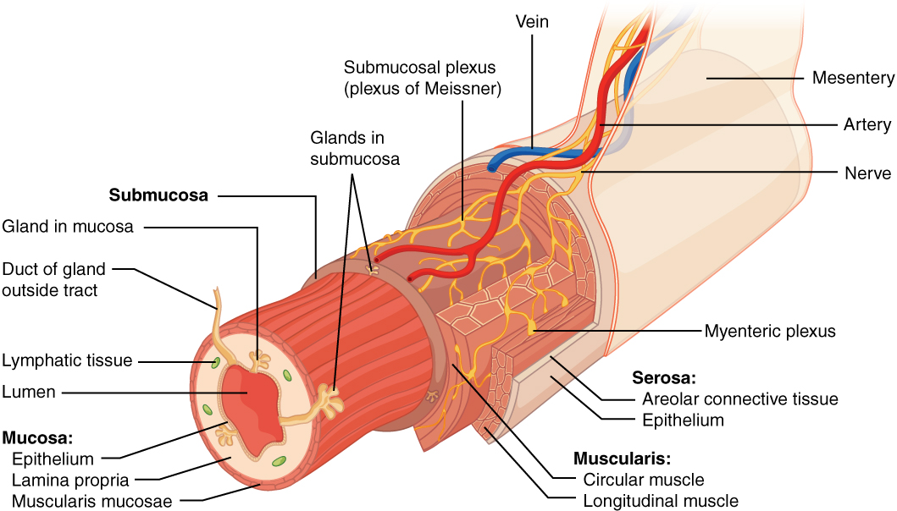
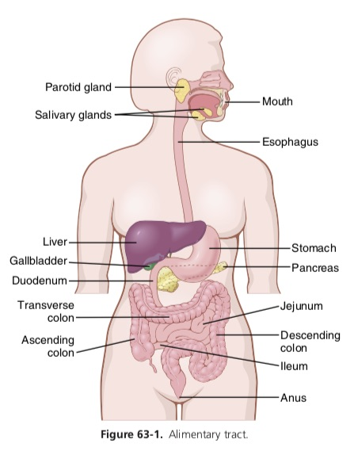

Slide 5
The primary symptom of the ”Acute abdomen" is: Abdominal pain.

Slide 6
Types of Abdominal Pain:
Three types of pain exist:
1. Visceral
2. Parietal
3. Referred

Slide 7
Visceral Pain
Due to stretching of fibers innervating the walls of hollow or solid organs.
It occurs early and poorly localized
It can be due to early ischemia or inflammation.

Slide 8
Parietal Pain
Caused by irritation of parietal peritoneum fibers.
It occurs late and better localized.
Can be localized to a dermatome superficial to site of the painful stimulus.

Slide 9
Referred Pain
Pain is felt at a site away from the pathological organ.
Pain is usually ipsilateral to the involved organ and is felt midline if pathology is midline.
Pattern based on developmental embryology.

Slide 10
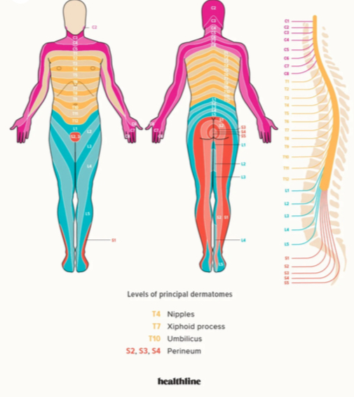
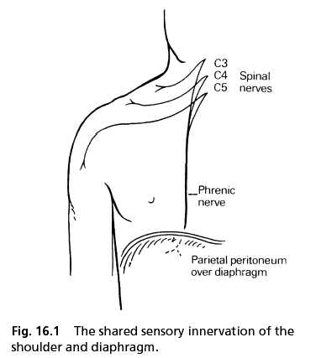

Slide 11
Referred Pain Locations
Referred pain is usually located in the cutaneous dermatomes sharing the same spinal cord level as the visceral inputs.
As an example, nociceptive inputs from the gallbladder enter the spinal cord at T5 to T10.

Slide 12
Two approaches to evaluate pts with acute abdominal pain:
Classification of Abd pain into systems
Abdominal Topography (4 quadrants)

Slide 13
Three main categories of abdominal pain:
Classification of Abd pain into systems
1. Intra-abdominal (arising from within the abd cavity / retroperitoneum) involves:
GI (Appendicitis, PUD, Intestinal obstruction)
GU (Renal Colic)
Gyn (Acute PID, Ectopic Pregnancy)
Vascular systems (AAA, Mesenteric Ischemia)

Slide 14
2. Extra-abdominal (less common) involves:
Cardiopulmonary (AMI)
Abdominal wall (Hernia, Zoster)
Toxic-metabolic (DKA, OD, Heavy metal poising)
Neurogenic pain (Zoster)
Psychic (Anxiety, Depression)

Slide 15
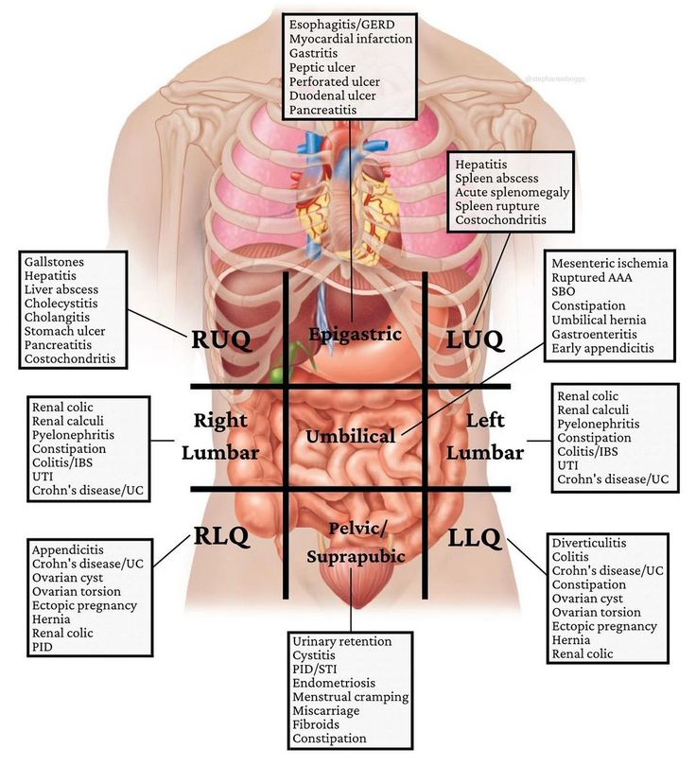
Abdominal Topography (4 quadrants)

Slide 16
Approach to patient with abdominal pain
General principle
A thorough history and physical examination
A 76% of diagnosis can be made with good history and physical examination.
An exact diagnosis often impossible to make after the initial assessment, and often relying on further investigation

Slide 17
History
Abdominal pain characterization
Acute versus chronic, location and radiation, temporal elements, quality, severity and precipitants or palliation
Associated symptoms
Other gastrointestinal symptoms: Nausea, vomiting, diarrhea, constipation, hematochezia, melena, and changes in stool (eg, change in caliber).
Genitourinary symptoms: Dysuria, frequency, and hematuria
Constitutional symptoms: Fevers, chills, fatigue, weight loss, and anorexia
Cardiopulmonary symptoms: Cough, shortness of breath, orthopnea, and exertional dyspnea
Other: Patients with diabetic ketoacidosis will have symptoms of polyuria and thirst.

Slide 18
History
Other medical history
Specific questions for females
Last normal menstrual period, previous menstrual period, cycle length) and use of contraception.
Hx of vaginal discharge or bleeding, dyspareunia or dysmenorrhea.
Past medical history: History of surgery, past Cardiovascular disease, and IBD
Medications: NSAID, recent antibiotics

Slide 19
History
Other history
Trauma
Alcohol: It is important to ask about alcohol intake to assess for the possibility of liver disease and pancreatitis.
Family history: IBD

Slide 20
Physical Examination
General appearance
A Patient who is restless, curled up, and agitated may have renal colic.
A patient lying perfectly still in bed experiencing worsening pain when the examiner lightly bumps the stretcher raises concern for peritonitis.
Signs of shock (eg, pallor, diaphoresis, altered mental status) warrant resuscitation simultaneously with the evaluation.
Signs of systemic disease (eg, spider angiomata in cirrhosis, cachexia in malignancy) are often readily apparent.

Slide 21
Physical Examination
Vital signs
Abdominal examination
Inspection: Identifies mobility of the abdomen, surgical scar, abdominal pulsations, distension, periumbilical ecchymosis (Cullen sign) and flank ecchymosis (grey-turner sign) and abdominal wall pathology such as a hernia.
Palpation: Identifies the location and degree of tenderness and detects signs of peritoneal irritation, such as involuntary guarding, muscular rigidity and rebound tenderness.
Murphy sign: (worsening pain and tenderness during deep inspiration with right upper quadrant palpation) is sensitive but not specific for acute cholecystitis.
Auscultation: Identifies hyperactive, obstructive, absent, or normal bowel sounds.
Percussion: Hyper-tympanicity signifies intestinal obstruction. Dullness signifies fluid accumulation

Slide 22
Physical Examination
GUS: Examine the scrotum for testicular edema and tenderness, epididymal tenderness, scrotal masses, and cremasteric reflexes.
Perform a pelvic examination in a female with pain and tenderness in the lower half of the abdomen.
Heart and lungs: Atrial fibrillation or valvular disease can increase suspicion for mesenteric ischemia secondary to vascular embolization.
Localized decreased or coarse breath sounds raise suspicion for pneumonia.
Musculoskeletal, back, and flank: Percuss the costovertebral angles as tenderness suggests pyelonephritis.
Skin: Examine for rashes, especially over the abdomen, back, and perineum. Zoster presents with a rash in the dermatomal distribution of the pain.

Slide 23
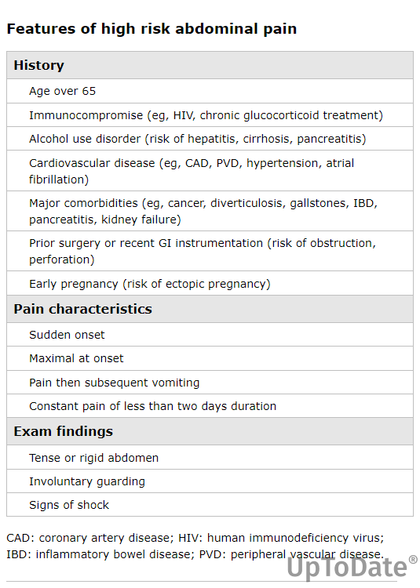

Slide 24
Laboratory Test
CBC
UA / Urine culture
Lactic acid, ABG
LFT/RFT/ Amylase / Lipase/Electrolyte
CE / Troponin
HCG (quant /qual): is required in all females of childbearing age with abdominal pain.
Stool exam: C.diff. toxin test.

Slide 25
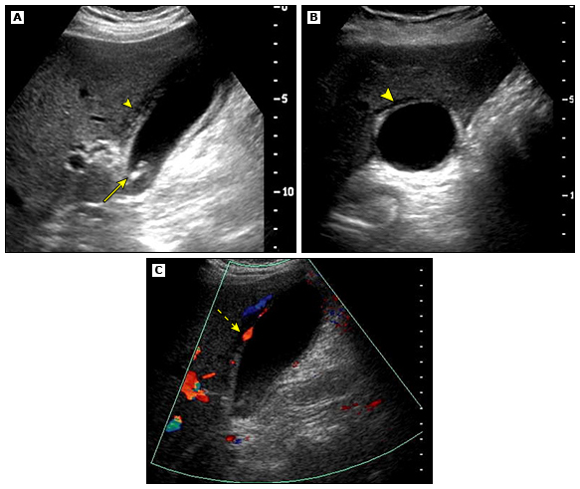
Radiographic Test
Chest radiograph (CXR)
Plain abdominal X ray
ECG
Abdominoplevic US
CT scan (with/without contrast)
MRI
Plain abdominal X ray

Slide 26
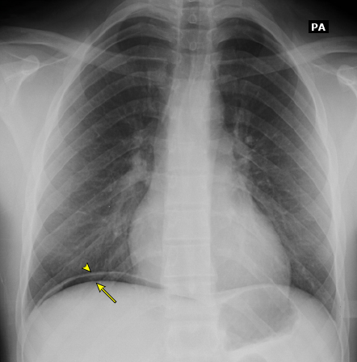
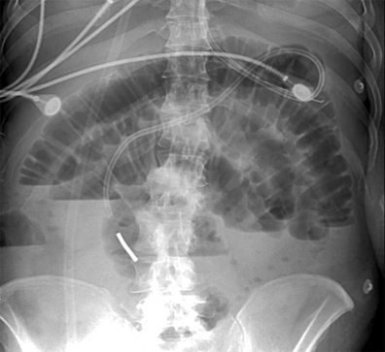
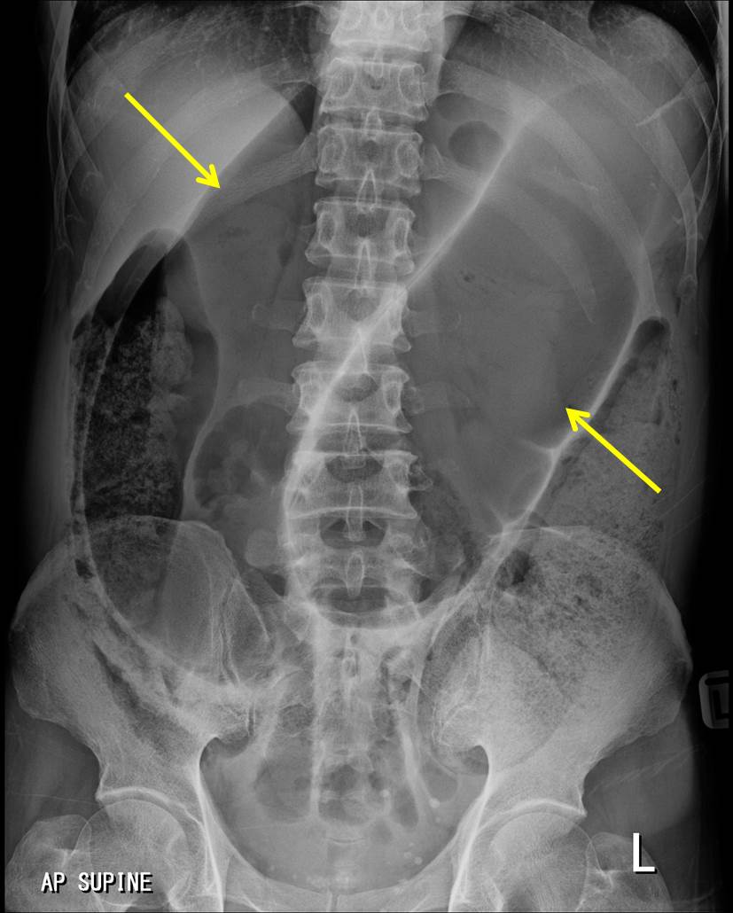

Slide 27
In patients above fifty years of age the top four reasons for acute abdominal pain are: Biliary Tract Disease (21%,) NSAP (16%), Appendicitis(15%), and Bowel Obstruction (12%).
In patients under fifty years of age the top three reasons for acute abdominal pain are: NSAP (40%,) Appendicitis (32%,)

Slide 28
Peritonitis

Slide 29
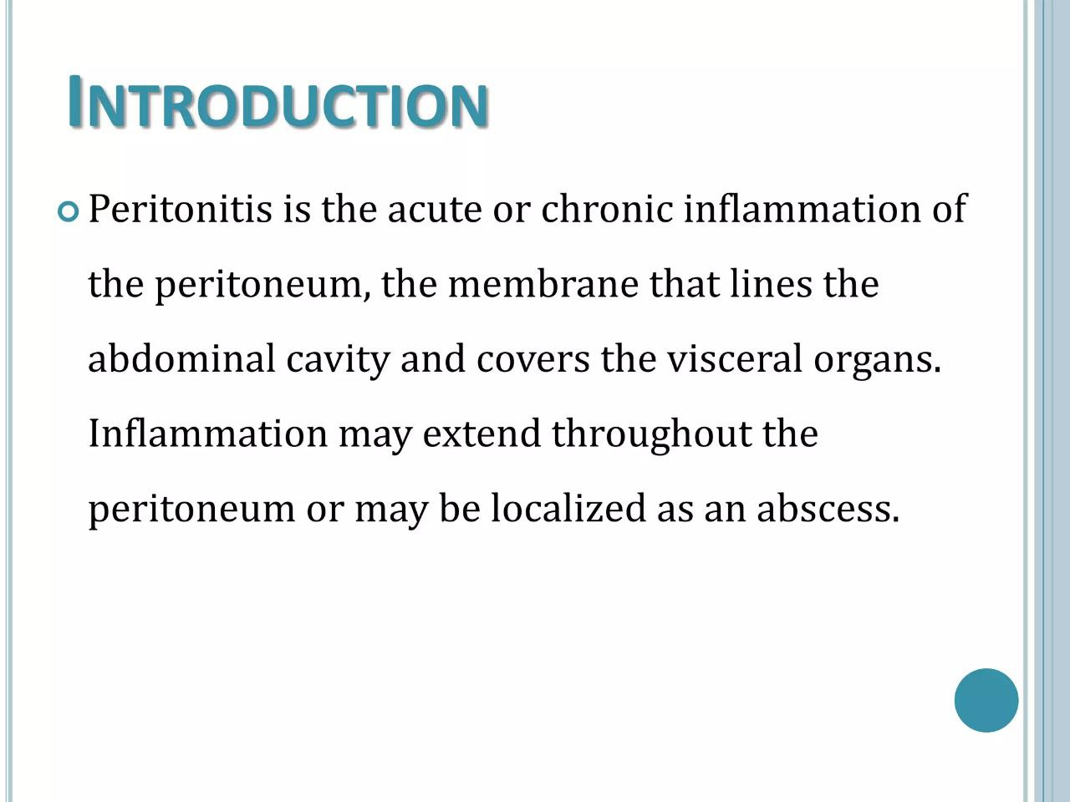

Slide 30
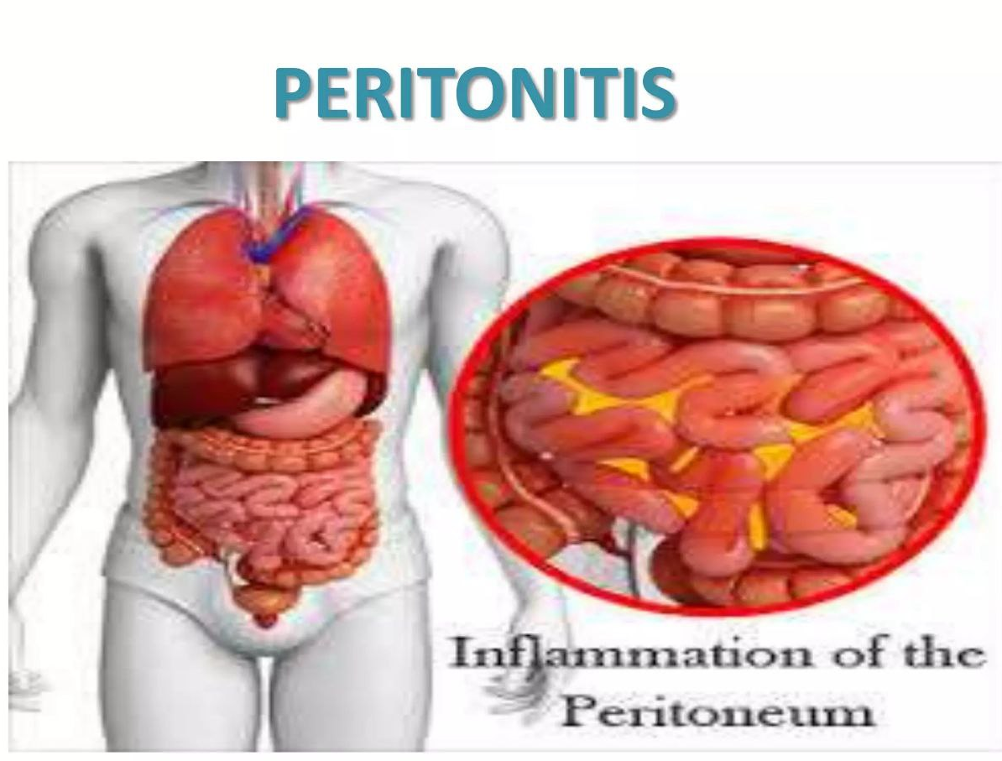

Slide 31
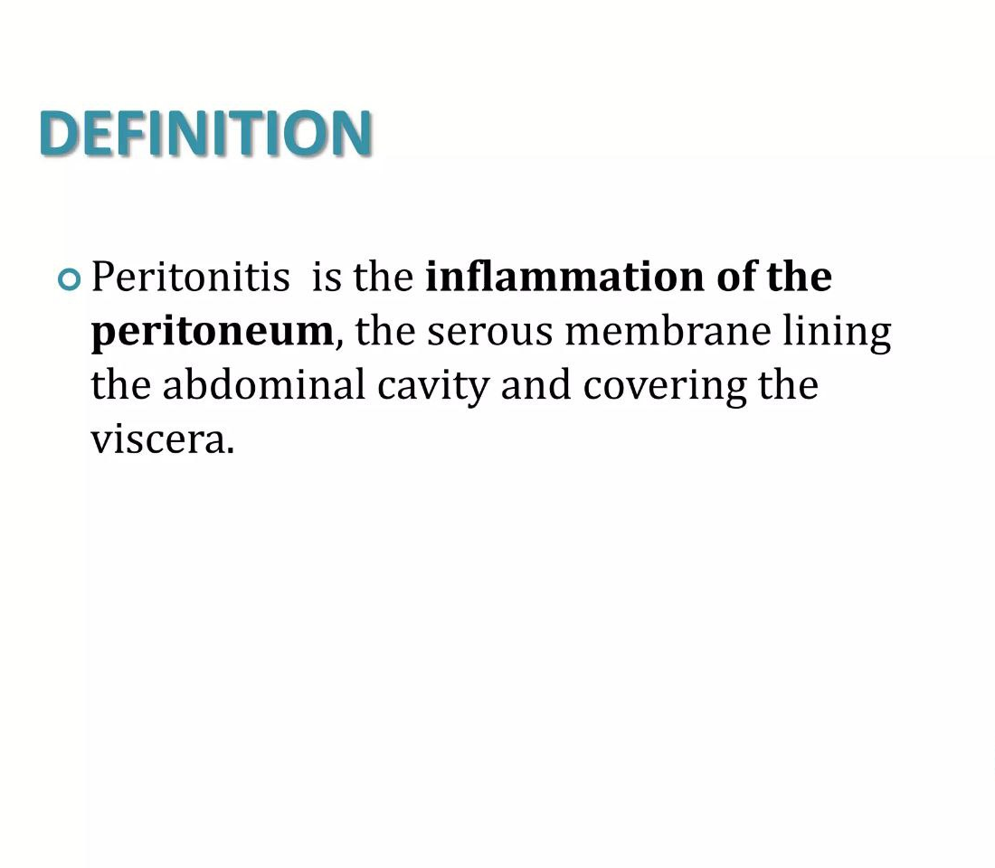

Slide 32
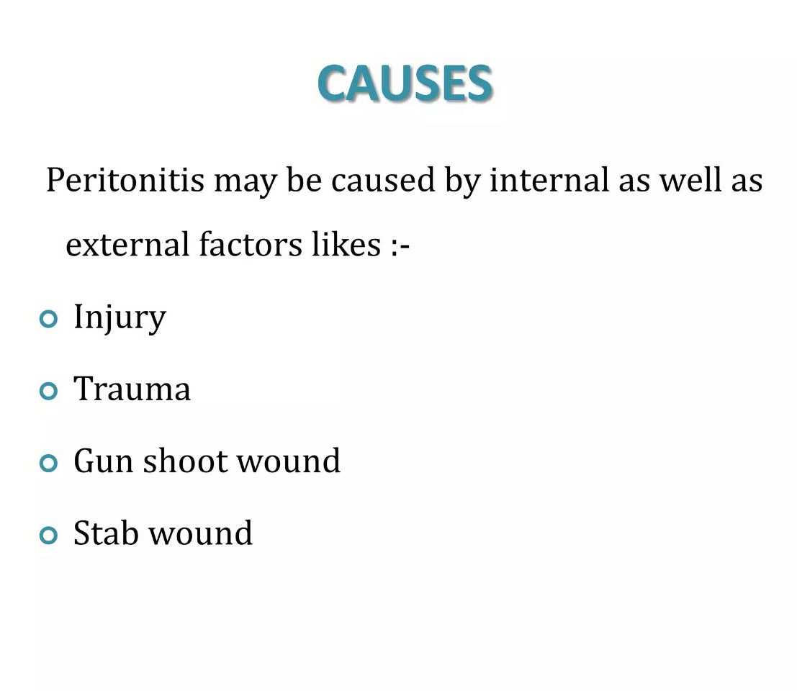

Slide 33
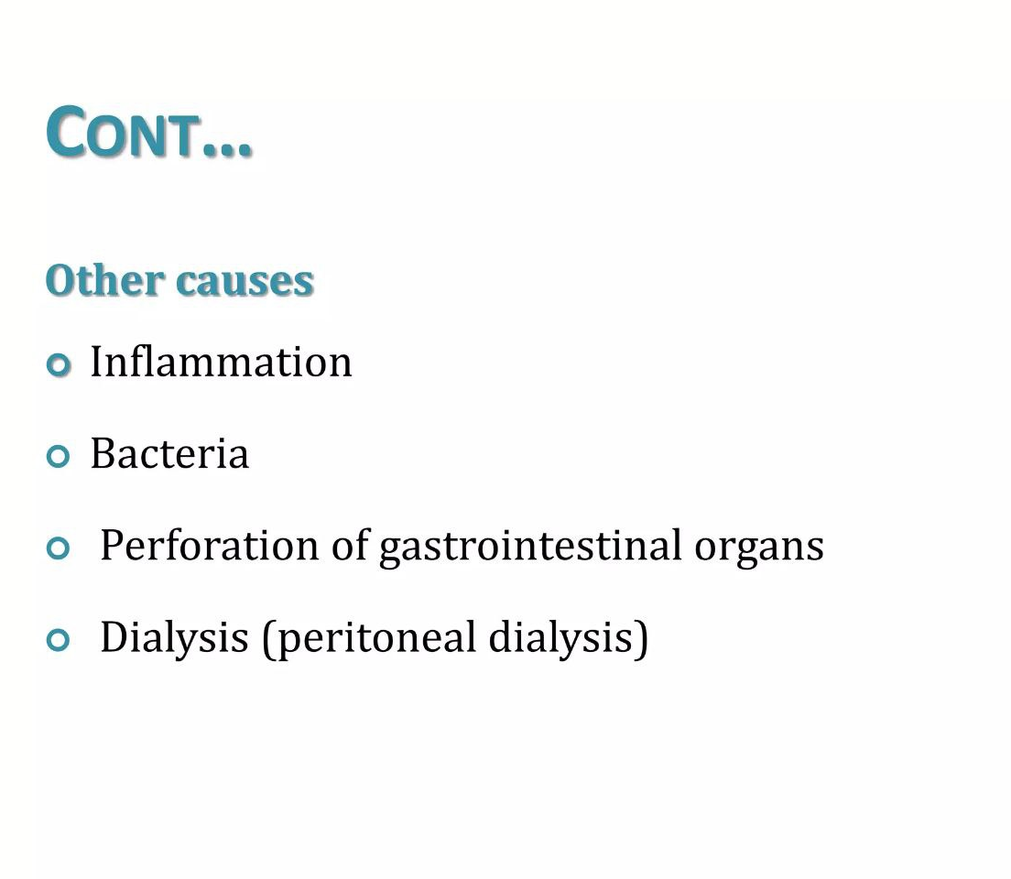

Slide 34
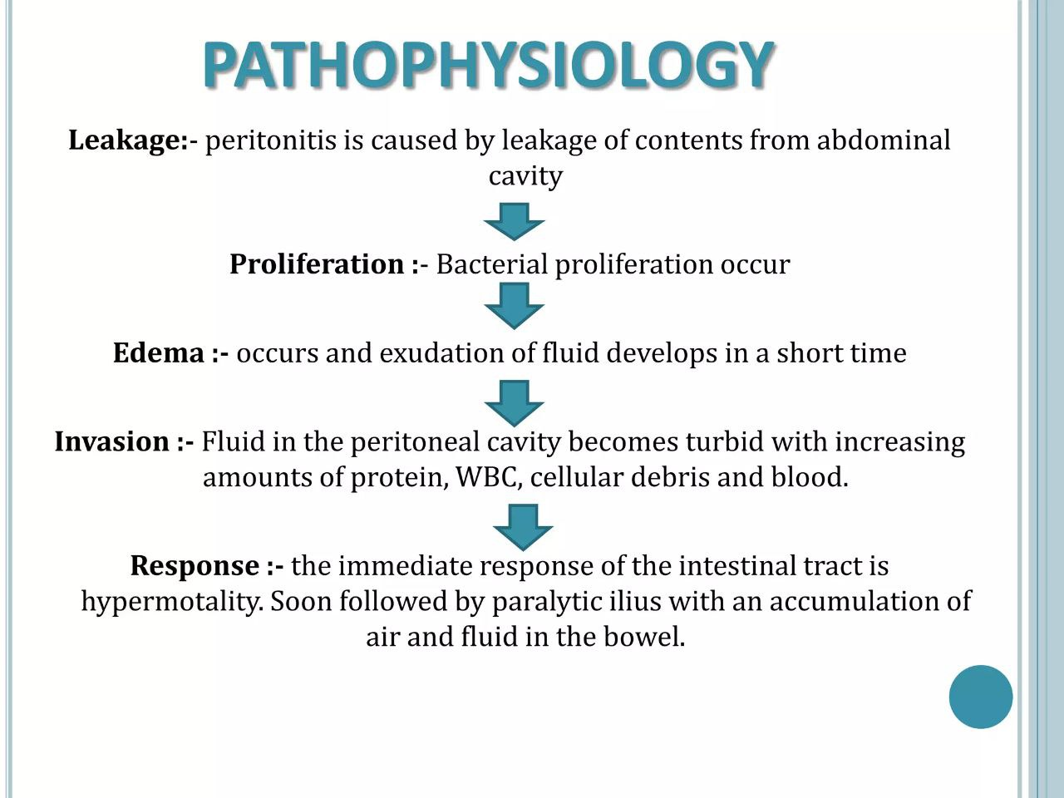

Slide 35
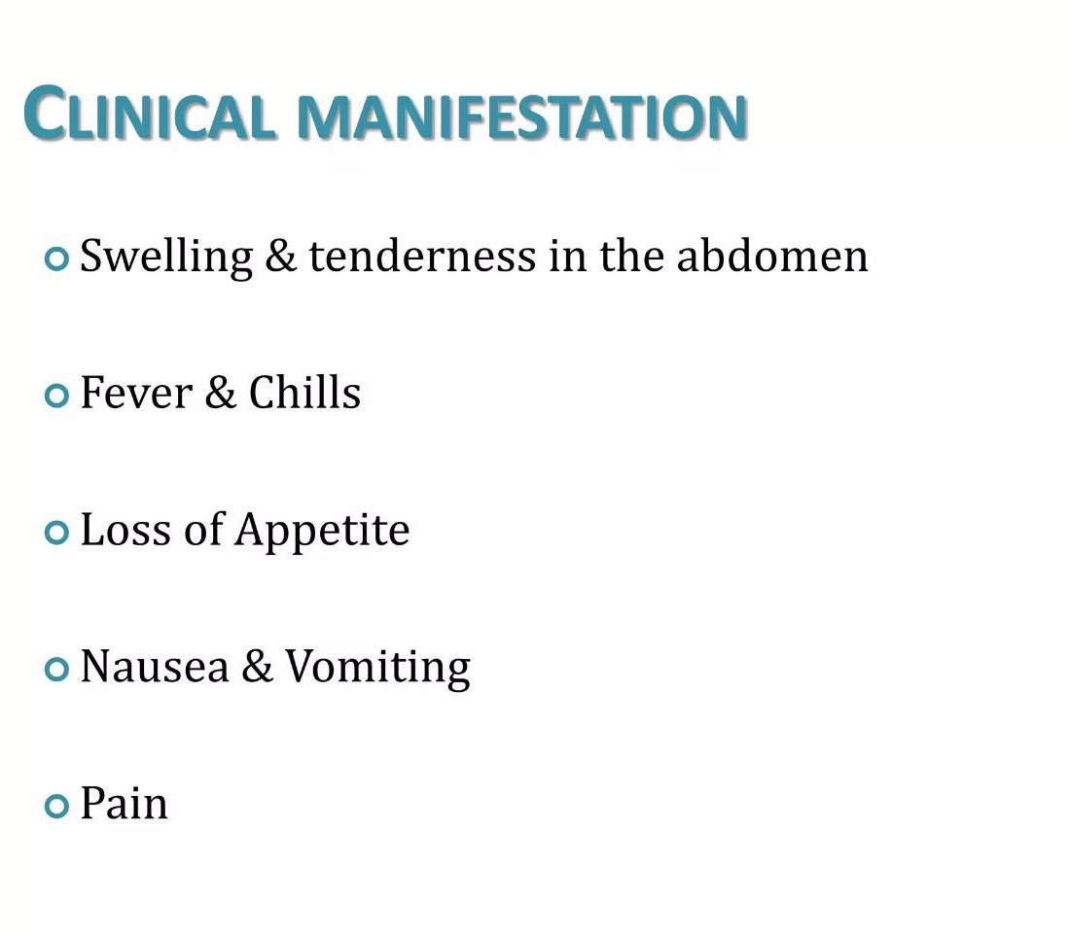

Slide 36
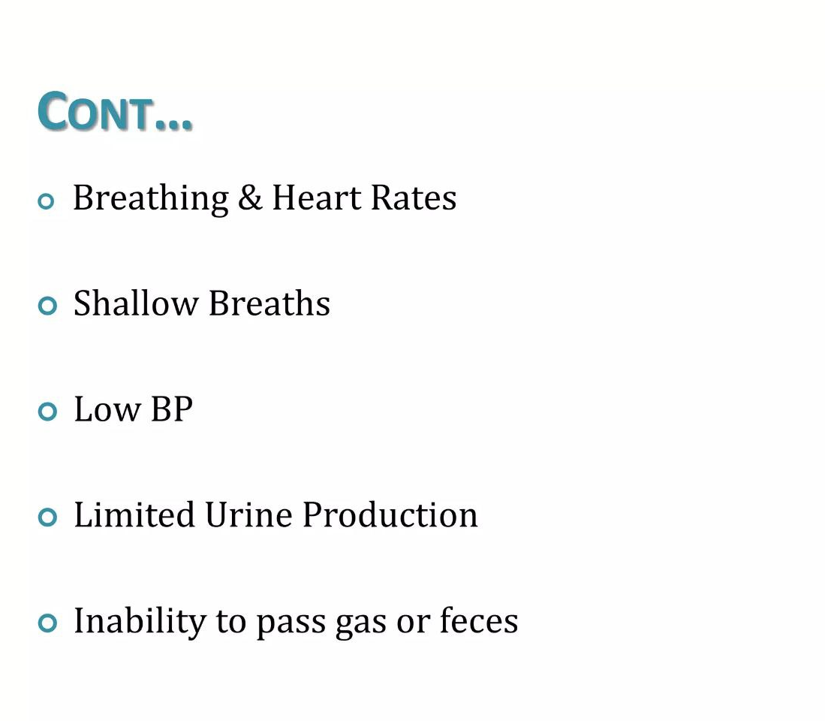

Slide 37
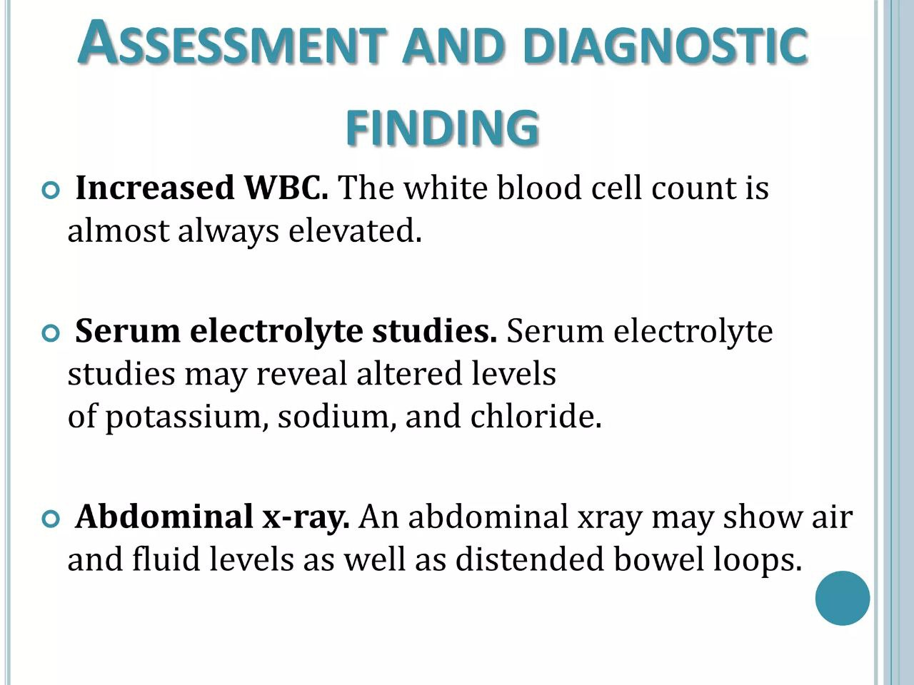

Slide 38
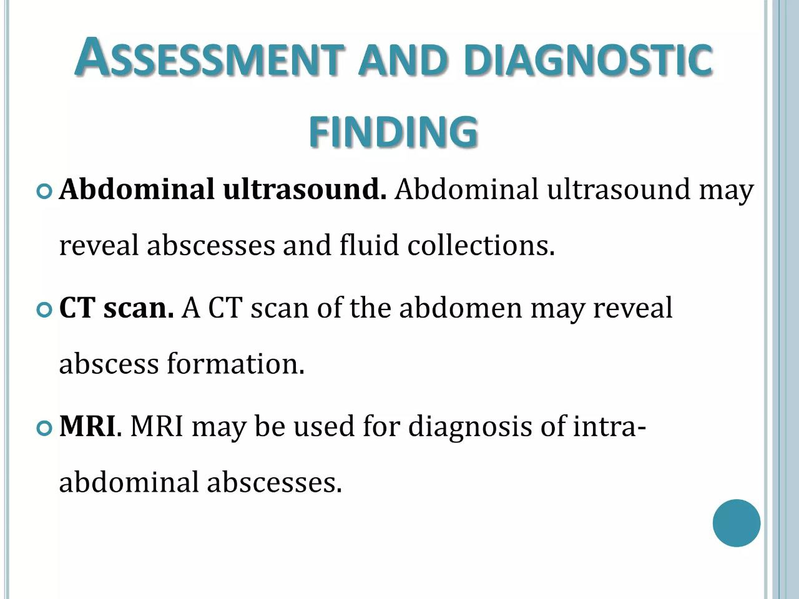

Slide 39
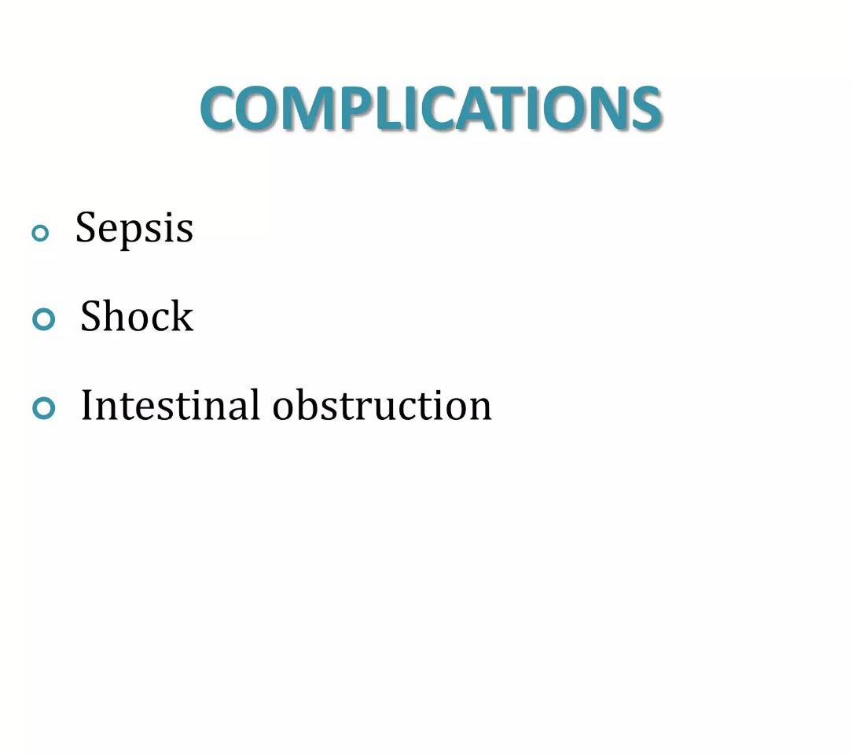

Slide 40
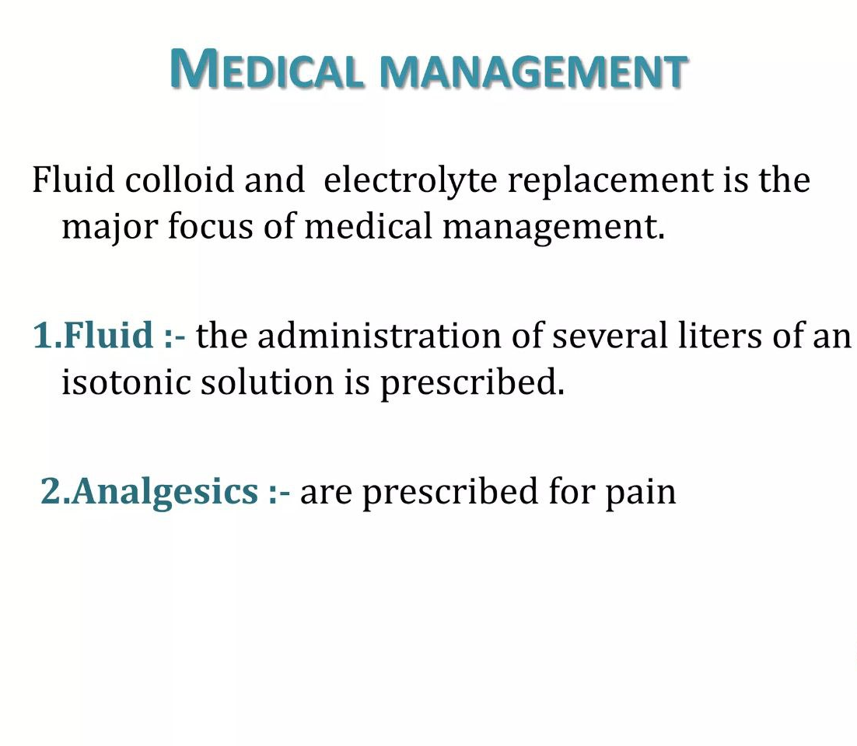

Slide 41
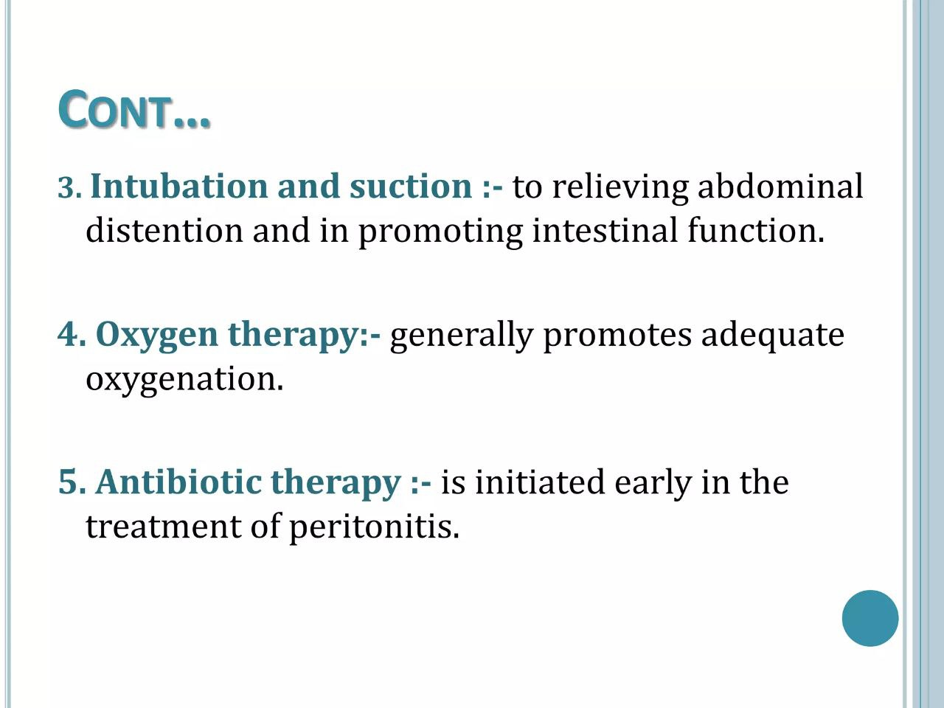

Slide 42
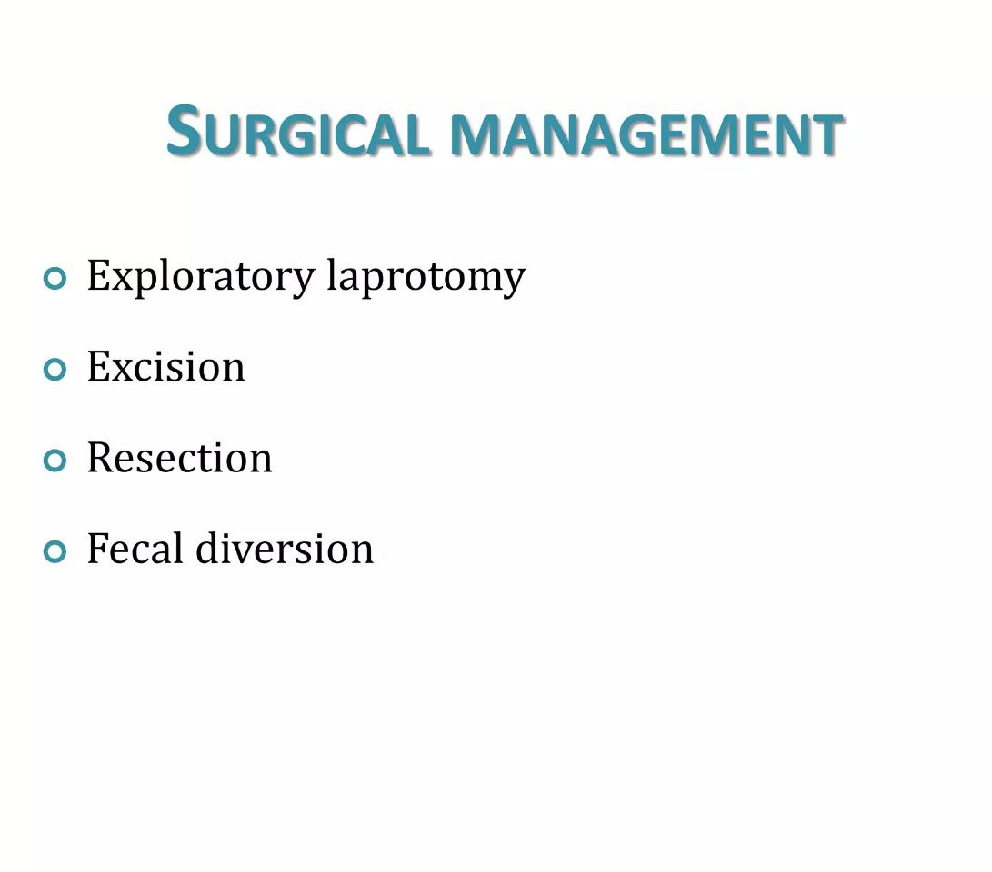

Slide 43
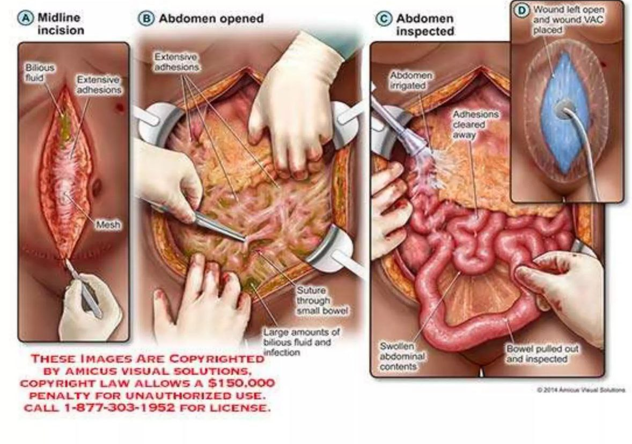

Slide 44
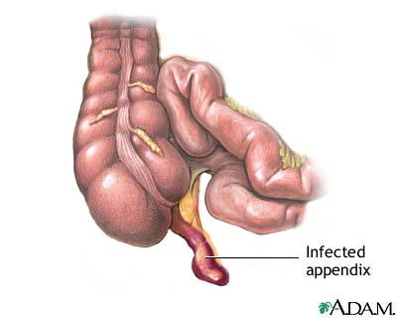
Appendicitis
Usually due to obstruction with fecalith.
Appendix becomes swollen, inflamed gangrene, possible perforation
Appendicitis occurs most frequently in the second and third decades of life.
The incidence is highest in the 10-to-19-year-old age group and lowest in children ≤9 years
It is also higher among men (male-to-female ratio of 1.4:1), who have a lifetime incidence of 8.6 % compared with 6.7 % for women.


Slide 45
Clinical features with some predictive value include:
Pain located in the RLQ
Pain migration from the periumbilical area to the RLQ
Pain before vomiting
Anorexia
Other features
Psoas sign
Obturator sign
Rovising sign

Slide 46
Ix:
CBC: Leuckocytosis and lift shift
Ultrasound:
Enlarged appendiceal diameter >6 mm with an occluded lumen
Appendiceal wall thickening (>2 mm)
Peri-appendiceal fat stranding
Appendiceal wall enhancement
Appendicolith (seen in approximately 25 percent of patients)
CT scan with and without contrast.

Slide 47
Mx:
Fluid and electrolyte resuscitation
Analgesia
Antibiotics
Surgery

Slide 48
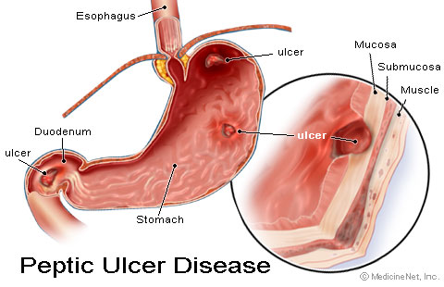
Peptic Ulcer Disease
Erosion of the lining of the stomach, duodenum.
Steady, well-localized epigastric or LUQ pain.
Described as a “burning”, “gnawing”, “aching”
Increased by coffee, stress, spicy food, smoking

Slide 49
Risk factors for PUD
H.pylori
Medication: NSAID and steroid
Complication of PUD
Bleeding, Perforation, GOO and Penetration.
Presentation of PUD Perforation
Hx: Sudden onset severe epigastric abdominal pain later become diffuse. Anorexia, Nausea
PE:ASL in pain with VS derangement (Tachycardia, fever, tachypenea and hypotention). Diffuse abdominal tenderness
Ix: CBC, Ele, OFT. CXR (Air under the diaghram in 60 to 70% of cases)

Slide 50
Mx: General principle of management
Resuscitation (correct fluid and electrolyte deficit).
High dose PPI (Omeprazole, 80mg IV loading then 40mg, IV, BID)
Secure NG tube
Analgesia
Broad spectrum antibiotics
Surgery (Omental patch)
Post OP H. pylori eradication
Life long PPI

Slide 51
Biliary Tract Disease
Most common diagnosis in ED of pts > 50.
Composed of:
Acute Cholecystitis (acalculus / calculus)
Biliary Colic
Common Duct Obstruction (Ascending Cholangitis: Charcot trid (RUQ abdominal tenderness, Jaundice and fever.

Slide 52
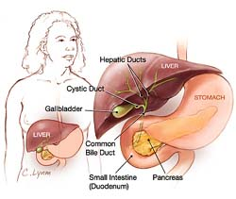
Acute Cholecystitis
Inflammation of gall bladder
Commonly associated with gall stones
More common in 30 to 50 year old females
Nausea, vomiting; RUQ pain, tenderness; fever
Attacks triggered by ingestion of fatty foods
Gangrenous, Empyema, emphysematous, perforated GB.

Slide 53
Ix:
CBC, OFT, Bilirubin, Ele.
US: is the initial test of choice for patients with suspected biliary tract disease.
More sensitive than CT scan to detect GB stone.
Gallbladder wall thickening (greater than 4 to 5 mm), pericholecystic fluid, or edema (double wall sign)
A "sonographic Murphy's sign" is more accurate than hand palpation.
CT scan, MRCP, ERCP.
MRCP has good specificity and sensitivity in picking up stones and common duct obstructions.

Slide 54
Mx:
Fluid and electrolyte deficit correction
NPO and MF
Analgesia
Broad spectrum antibiotics
Surgery (Emergency or interval cholecystectomy)

Slide 55
Intestinal Obstruction
Blockage of inside of intestine
Interrupts normal flow of contents
Causes include adhesions, hernias, fecal impactions, tumors
Cardinal symptoms of intestinal obstruction: Abdominal pain, vomiting and obstipation.
It can be SBO, LBO or both
It can be complete or partial obstruction

Slide 56
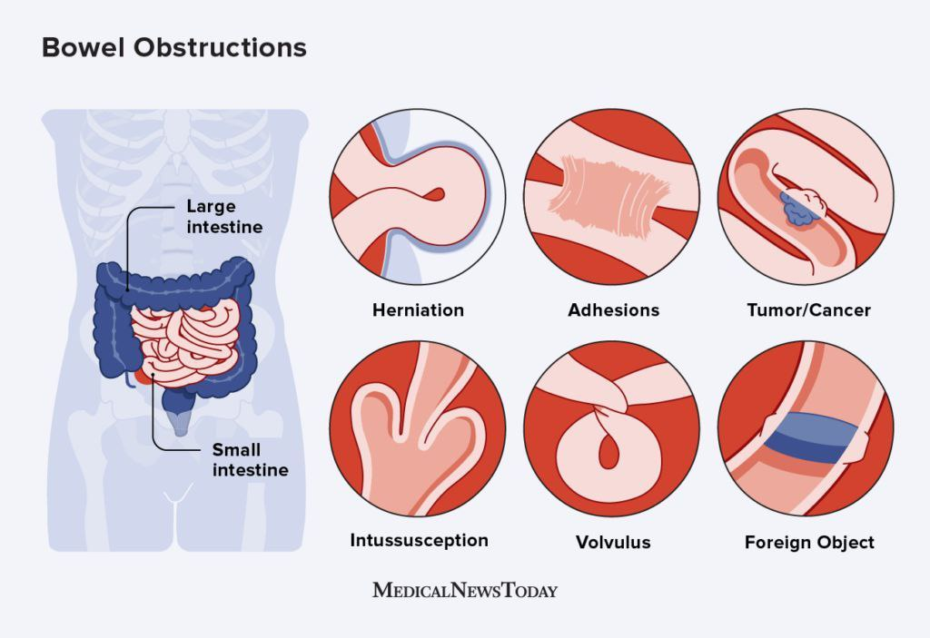

Slide 57
Ix:
CBC, OFT, Ele
Lactate
Tumor markers (CEA)
Plain abdominal x ray
Abdomino-plevic CT scan with contrast

Slide 58
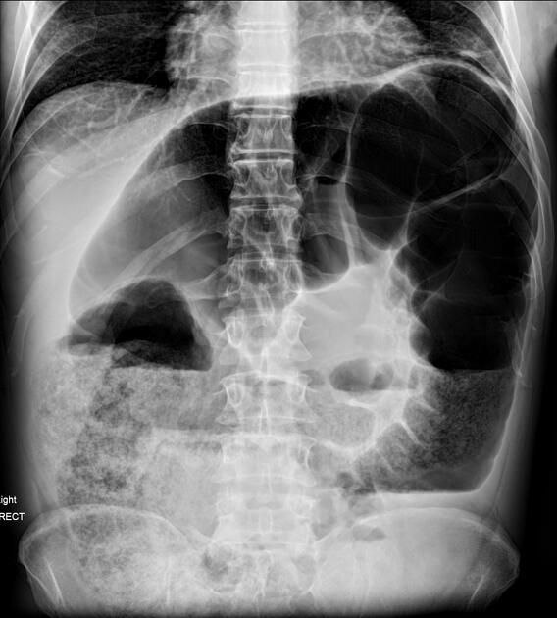
Small Bowel
Central
Valvulae conniventes
Dia > 5cm
Large Bowel
Peripheral
Haustrae
Dilation > 10cm

Slide 59
Mx
SBO 2ry to Adhesion
Resuscitation
NPO and MF
NG tube decompression
Analgesia
+ Antibiotics
Conservative management
Surgery
LBO 2ry to SV
Resuscitation
NPO and MF
Rectal tube deflation
+ Antibiotics and analgesia
Surgery (Emergency or interval)

Slide 60
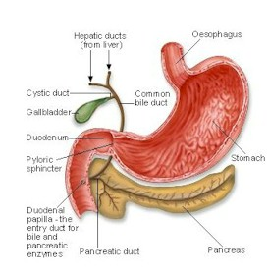
Pancreatitis
Inflammation of pancreas
It can be mild, moderate or severe

Slide 61
Etiology
80% of cases are due to ETOH abuse or gallstones.
Other common causes:
Drugs ( Valproic acid, Tetracycline, Hydrochlorothiazide, Furosemide)
Pancreatic cancer
Abdominal trauma/surgery
Ulcer with pancreatic involvement
Familial pancreatitis (Hypertriglycerides / Hypercalcemia)
Iatrogenic (ERCP)
In Trinidad, the sting of the scorpion Tityus trinitatis is the most common cause of acute pancreatitis

Slide 62
Presentation: severe abdominal pain radiating from upper abdomen straight through to back, and nausea, vomiting.
The inflammatory process around the pancreas may cause other signs and symptoms such as:
Pleural effusion
Grey Turner's sign ( flank discoloration )
Cullen's sign ( discoloration around the umbilicus )
Ascites
Jaundice

Slide 63
Ix:
CBC, OFT, Ele, Lipase and amylase
Abdominal US/CT scan with contrast/MRI
Diagnosis: The diagnosis of acute pancreatitis requires the presence of two of the following three criteria:
Acute onset of persistent, severe, epigastric pain often radiating to the back,
Elevation in serum lipase or amylase to three times or greater than the upper limit of normal, and
Characteristic findings of acute pancreatitis on imaging (contrast-enhanced computed tomography [CT], magnetic resonance imaging [MRI], or transabdominal ultrasonography)
Mx: Admission to ward, ICU
Fluid resucitation
Pain management
Strict follow up
Surgery (Complication, etiology (GB stone))

Slide 64
Ureteric Colic
Mineral deposits form in kidney, move to ureter.
Px: Pts may present with abrupt, colicky, unilateral flank pain that radiates to the groin, testicle, or labia, Hematuria
Ix: KUB
Non-contrast helical CT is standard for the diagnosis
Mx: Pain management
Expectant management
Medical expulsion therapy
Operative intervention

Slide 65
Special Considerations
In pts >50 you must consider mesenteric ischemia, ischemic colitis, and AAA.
In an elderly patient symptoms do not manifest in the same manner as those younger.
Compared to young pts, only 20% of elderly pts with abdominal pain will be diagnose with NSAP
Assume an elderly patient has a surgical cause of pain unless proven otherwise.
40% of those > 65 yrs old that present to ED with abdominal pain need surgery.

Slide 66
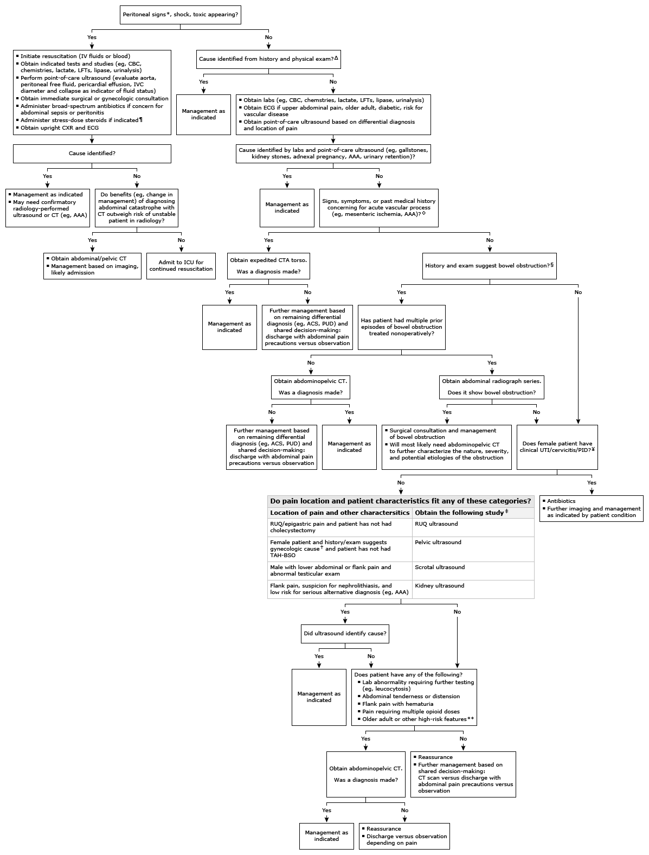
Summary

Slide 67
??? QUESTION #1 ???
A 45 year-old male patient presents with severe abdominal pain which is worse with movement. He has fever, tachycardia, tachypnea and a narrow pulse pressure. There is guarding, and rebound tenderness in the right lower quadrant. Which of the following is the most likely diagnosis?
Perforated appendicitis
Acute unperforated appendicitis
Perforated gallbladder
Ruptured diverticulum
Acute cholecystitis

Slide 68
??? QUESTION #2 ???
A 45 year-old male with peptic ulcer disease (PUD) presents to the ED with an abrupt onset of severe epigastric pain 1 hour prior to arrival. Abd exam leads you to suspect an early acute surgical abdomen. Describe the findings and treatment with this complication of PUD. Physical examination findings suggestive of perforation include all of the following except?
A reactive pleural effusion is frequent seen with gastric perforation.
Tympany may indicate free air, confirmed by upright chest x-ray or lateral decubitus film
Acute pancreatitis may result from posterior perforation.
Chemical peritonitis progresses to abdominal rigidity, bacterial peritonitis and sepsis.

Slide 69
??? QUESTION #3 ???
Acute pancreatitis may range from mild inflammation to severe hemorrhagic pancreatitis with extensive necrosis of the gland. Serum amylase and lipase are elevated. Laboratory findings suggesting a poor prognosis include all of the following except:
Elevated blood glucose
Elevated hematocrit (due to dehydration)
Elevated LDH
Elevated WBC
Elevated AST

Slide 70
??? QUESTION #4 ???
Most hernias are asymptomatic, but signs and symptoms may include all of the following except:
Chronic postprandial pain and belching.
Nausea and vomiting with pain, inflammation and toxicity, progressing to perforation, peritonitis and sepsis with strangulated hernias.
Abdominal or focal pain and tenderness, possibly with signs of obstruction with incarceration. Possibly tachycardia and fever, leukocytosis and left shift.
Local swelling; intermittent "dragging" sensation or minor aching discomfort.

Slide 71
??? QUESTION #5 ???
All of the following are true regarding the plain radiographic evaluation of bowel obstruction except:
A stepladder pattern of air-fluid levels suggests obstruction.
Gas in the rectum or sigmoid excludes obstruction.
A dilated loop may terminate abruptly at the site of obstruction.
Obtain an upright chest x-ray to exclude free air in the abdomen.
Obtain flat and upright abdominal films or decubitus films to look for air fluid levels.
Dilated loops without stepladder air-fluid levels may be due to ileus.

Slide 72
ANSWERS
A -These findings are highly suggestive of bacterial peritonitis and sepsis.
A
B
A
A -With complete obstruction, distal gas will usually be absent. Gas may still be present early in obstruction, however, or may be introduced during the rectal examination.

Slide 73
Reference
UpToDate, 2024
Schwartz principle surgery 12th edition

Slide 74
THANK YOU ☺

